Slide 1


Data-Driven Storytelling Presentation:
Account Sales
Data Analysis

Slide 2
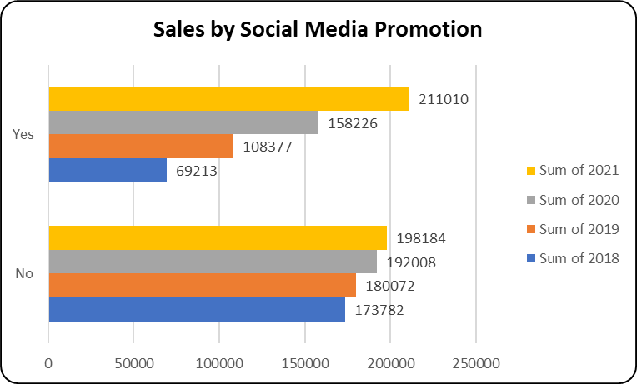
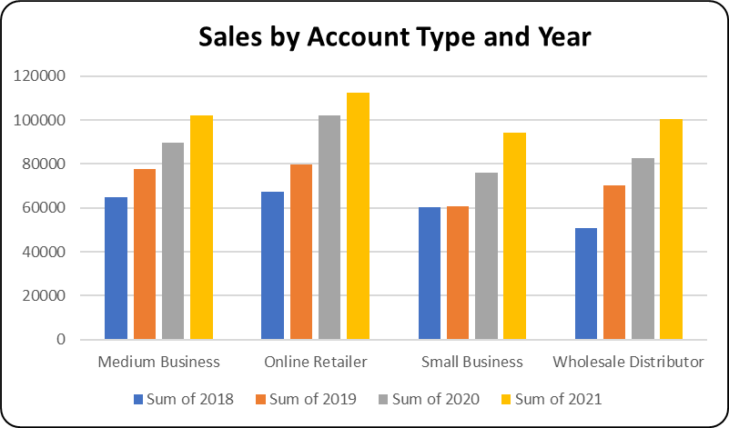
Social Media a best platform to promote and advertise to increase the sales.
Customers prefer online shopping as the schedules are getting busy and the advancement of technologies

Slide 3
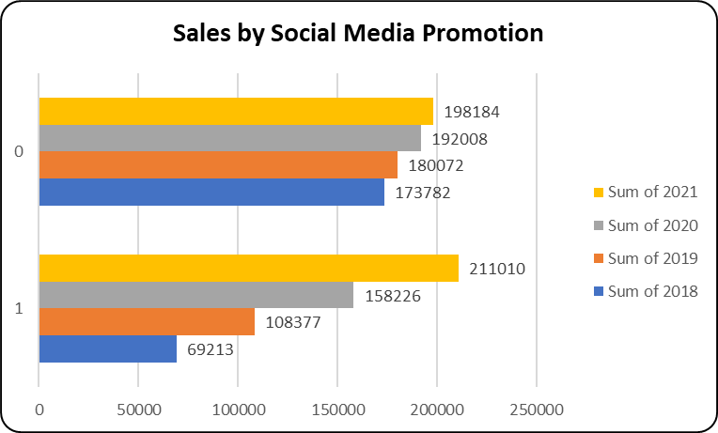
Key point, observation or data here…
Advancement in the technology and the busy life of people in this current scenario leading to shopping and trading of all goods, items in online mode rather than offline mode as it reduces the wastage of time, money and energy in the enormous traffic in the cities specially metro cities.
Hence the graph on the left side speaks the same story that there is significant growth in every account type but the growth of online sector is very rapid as compared to other three.
Engagements between businesses and customers increase the brand's sales and brand loyalty. One report revealed that 52% of social media marketers believe social media positively influences their company's revenue and sales.
Hence the graph on the left side speaks the same story that there is significant growth 2021 when there is social media promotion and in recent year the gowth of social media is very significant.

Slide 4
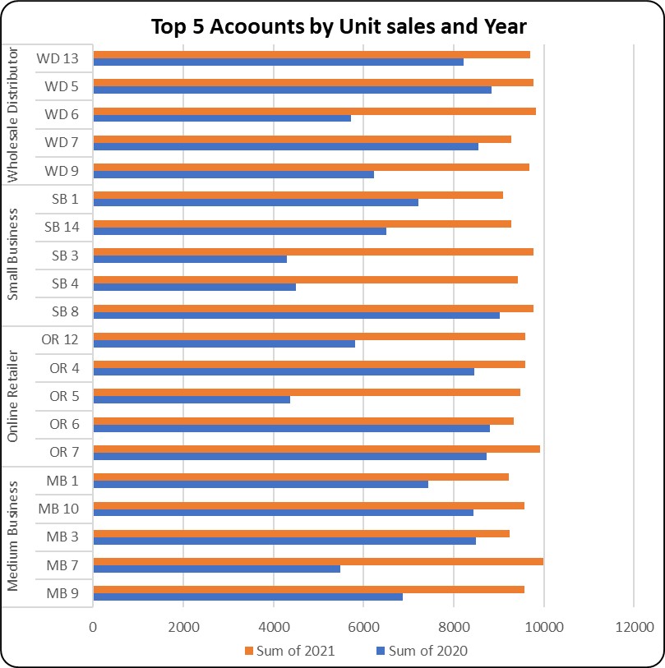
Key point, observation or data here…
Retaining customers is about more than just transactions - it is about relationships. Research shows that customers view their relationships with brands similarly to their relationships with friends. Customers like brands that are reliable, authentic and aware of what matters to them. Focus on buyer relationships with your existing customers to boost their brand loyalty. These shoppers will continue to choose your brand even when presented with other options. With this loyal base, your brand will be more likely to weather explosive markets.
Hence the graph on the left side depeicts the top 5 customers from each account type so the company must focus on these customers and maintain a healthy relationship with them

Slide 5
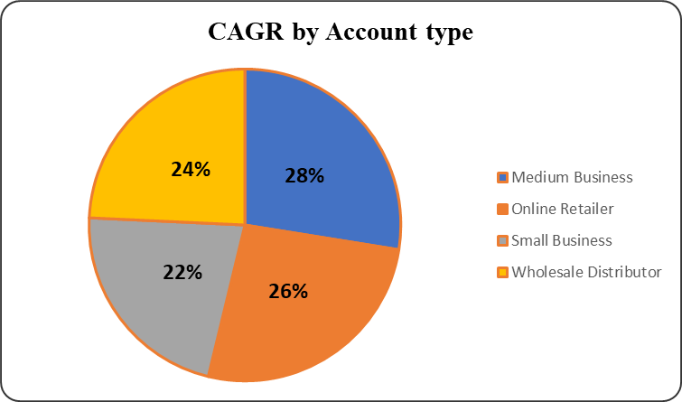
Key point, observation or data here…
CAGR (Compound Annual Growth Rate) measures your investments' average annual growth over a given period. It shows you the average rate of return on your investments over a year. CAGR is a helpful tool for investors because it precisely measures investment growth (or decline) over time. When calculating CAGR, profits are assumed to be reinvested at the end of each year of the time horizon. Therefore, CAGR is a representative number, not an accurate return. In most cases, an investment cannot grow at the same rate year after year. Despite this, the CAGR calculator is widely used to compare alternative investments..
The pie chart on the left hand side shows that 5 Year CAGR value of all account type is almost same but investors most likely to invest on Medium business as it takes the highet share amogst all.

Slide 6
Summary
From the deep analysis of the data provided by the client the following insights will definitely increase the sales of the company:-
In upcoming years Online Shopping will be more preferred by the customers so the company must give special focus to grow online sector.
Social Media promotion has a very high impact on sales as the growth of Social media is very high and rapid so advertisement through social media should be more prioritize .
Company should give special attention to the top customers and should maintain healthy relationship with them as in business relationship with customers is very important.

